Slide 1
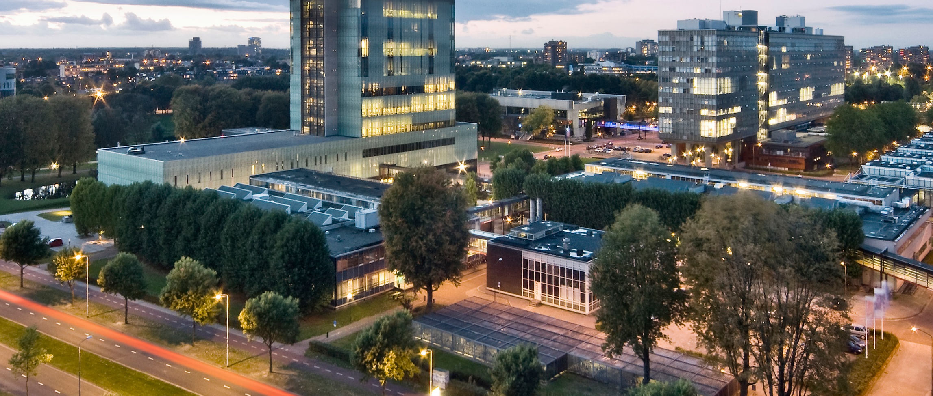
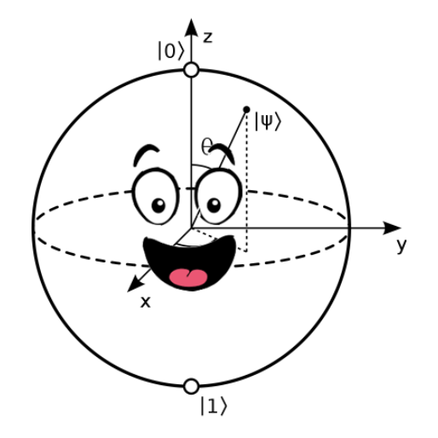
Quantum computing in the noisy intermediate-scale quantum (NISQ) era
Lecture 4: Variational Quantum Algorithms
Robert de Keijzer, r.j.p.t.d.keijzer@tue.nl

Slide 2
Download from: bit.ly/43blrmh
Unpack the Ottawa_QC_Wokrhsop.zip file somewhere you can access
If you don’t have it yet, download Anaconda from https://www.anaconda.com/products/distribution
When installed, open the Anaconda Prompt terminal (from your searchbar or any other way) (if you have linux or iOS, run the code below from your regular terminal)
Create a new conda environment (for instance with name “CASA_workshop”) with the command
conda create --name Ottawa_QC
5. Activate the environment using
conda activate Ottawa_QC
Install pip using:
conda install pip
7. Install packages using
pip install jupyter
pip install qutip
pip install matplotlib==3.4
8. Open Jupyter using
jupyter notebook
9. Navigate to the directory you unpacked the zip file

Slide 3
Slides can be found at: https://aiquantum.uottawa.ca/

Slide 4
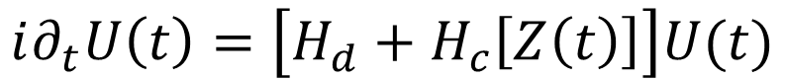
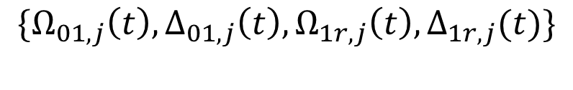
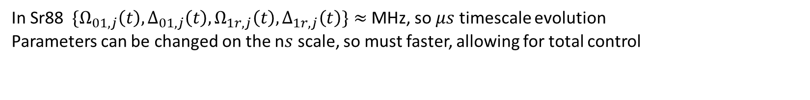
Recap
$$\{Ω_{01,j}\left(t\right), Δ_{01,j}\left(t\right),Ω_{1r,j}\left(t\right), Δ_{1r,j}(t)\}$$
$$i∂_{t}U\left(t\right)=\left[H_{d}+H_{c}\left[Z\left(t\right)\right]\right]U(t)$$
Drift Hamiltonian: natural ‘always on’ evolution of the system
Control Hamiltonian
control of system
In Sr88 $\{Ω_{01,j}\left(t\right), Δ_{01,j}\left(t\right),Ω_{1r,j}\left(t\right), Δ_{1r,j}\left(t\right)\}≈$ MHz, so $μs$ timescale evolution
Parameters can be changed on the n$s$ scale, so must faster, allowing for total control

Slide 5
Single Qubit gates on Rydberg
For full control: X, Y and Z rotations
$$H_{l−a,01}(t)=\frac{1}{2}\left(Ω(t)e^{iφ\left(t\right)}|0⟩⟨1|+Ω(t)e^{−iφ(t)}|1⟩⟨0|\right)−Δ(t)|1⟩⟨1|$$
$Ω\left(t\right)=0, Δ\left(t\right)=Δ, φ\left(t\right)=0: U\left(t\right)=\exp\left(−iΔ\left(\begin{matrix}0 & 0 \\ 0 & 1\end{matrix}\right)t\right)=$ $\left(\begin{matrix}1 & 0 \\ 0 & e^{−iΔt}\end{matrix}\right)$
$Ω\left(t\right)=Ω, Δ\left(t\right)=0, φ\left(t\right)=0: U\left(t\right)=\exp\left(−iΩ\left(\begin{matrix}0 & 1 \\ 1 & 0\end{matrix}\right)t\right)=$ $\left(\begin{matrix}\cos{(Ωt)} & −i\sin{(Ωt)} \\ −i sin⁡(Ωt) & \cos{(Ωt)}\end{matrix}\right)$

Slide 6
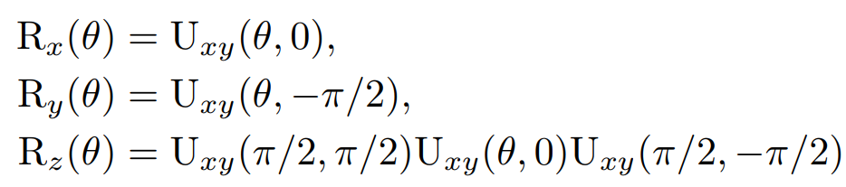
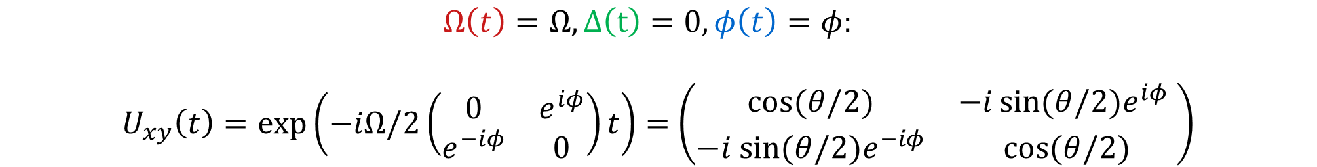
Single Qubit gates on Rydberg
For full control: X, Y and Z rotations
$$H_{l−a,01}(t)=\frac{1}{2}\left(Ω(t)e^{iφ\left(t\right)}|0⟩⟨1|+Ω(t)e^{−iφ(t)}|1⟩⟨0|\right)−Δ(t)|1⟩⟨1|$$
$$Ω\left(t\right)=Ω, Δ\left(t\right)=0, φ\left(t\right)=φ:$$
$U_{xy}\left(t\right)=\exp\left(−iΩ/2\left(\begin{matrix}0 & e^{iφ} \\ e^{−iφ} & 0\end{matrix}\right)t\right)=$ $\left(\begin{matrix}\cos{(θ/2)} & −i\sin{(θ/2)e^{iφ}} \\ −i sin⁡(θ/2)e^{−iφ} & \cos{(θ/2)}\end{matrix}\right)$
$$θ:=Ωt$$

Slide 7
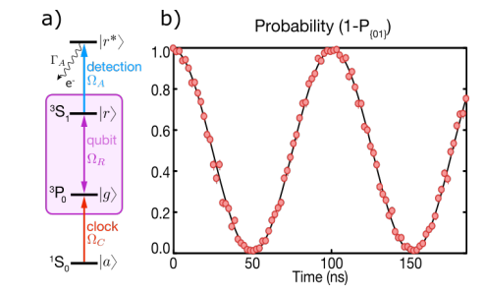
Experimental Implementation of X gate
Source: Nat. Phys. 16, 857-861 (2020)

Slide 8
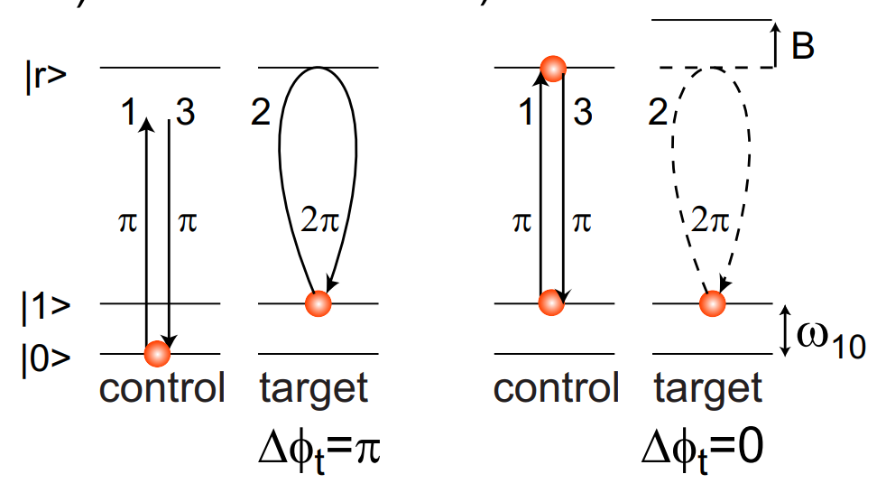
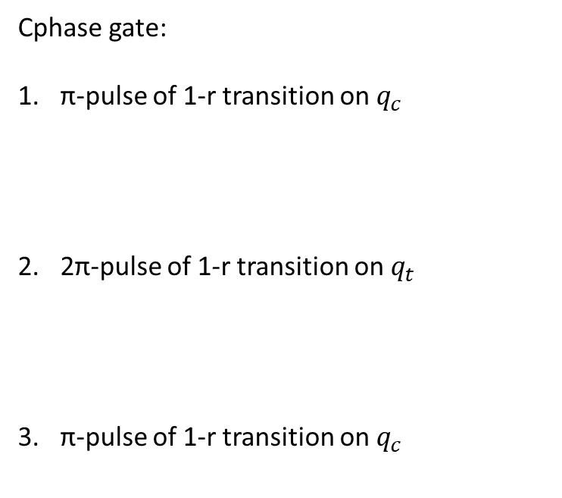
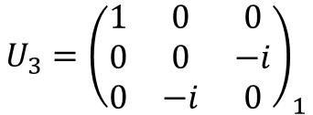
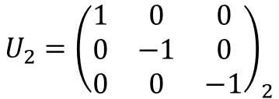
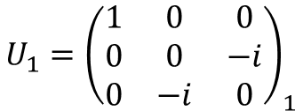
Two qubit gates on Rydberg
Cphase gate:
π-pulse of 1-r transition on $q_{c}$
2π-pulse of 1-r transition on $q_{t}$
π-pulse of 1-r transition on $q_{c}$
$${U_{1}=\left(\begin{matrix}1 & 0 & 0 \\ 0 & 0 & −i \\ 0 & −i & 0\end{matrix}\right)}_{1}$$
$${U_{2}=\left(\begin{matrix}1 & 0 & 0 \\ 0 & −1 & 0 \\ 0 & 0 & −1\end{matrix}\right)}_{2}$$
$${U_{3}=\left(\begin{matrix}1 & 0 & 0 \\ 0 & 0 & −i \\ 0 & −i & 0\end{matrix}\right)}_{1}$$

Slide 9
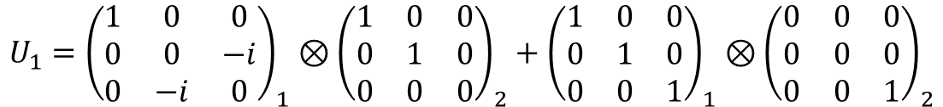
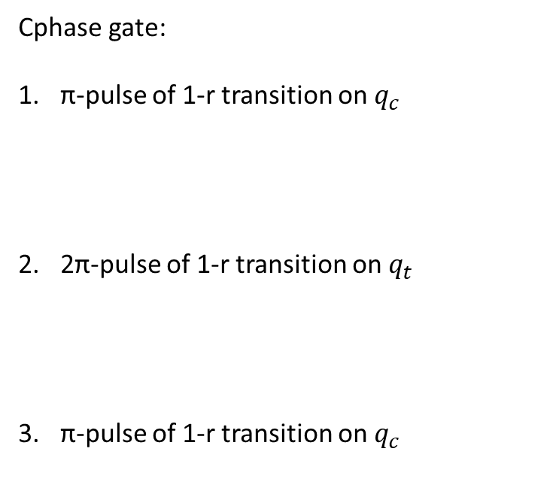
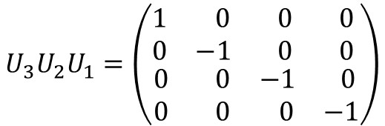
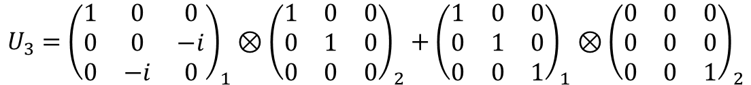
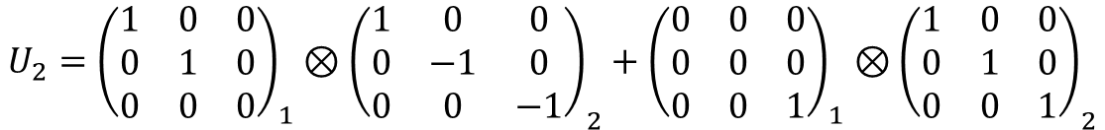
Two qubit gates on Rydberg
Cphase gate:
π-pulse of 1-r transition on $q_{c}$
2π-pulse of 1-r transition on $q_{t}$
π-pulse of 1-r transition on $q_{c}$
$${U_{1}=\left(\begin{matrix}1 & 0 & 0 \\ 0 & 0 & −i \\ 0 & −i & 0\end{matrix}\right)}_{1}⊗{\left(\begin{matrix}1 & 0 & 0 \\ 0 & 1 & 0 \\ 0 & 0 & 0\end{matrix}\right)}_{2}+{\left(\begin{matrix}1 & 0 & 0 \\ 0 & 1 & 0 \\ 0 & 0 & 1\end{matrix}\right)}_{1}⊗{\left(\begin{matrix}0 & 0 & 0 \\ 0 & 0 & 0 \\ 0 & 0 & 1\end{matrix}\right)}_{2}$$
$$U_{3}U_{2}U_{1}=\left(\begin{matrix}\begin{matrix}1 & 0 \\ 0 & −1\end{matrix} & \begin{matrix} 0 & 0 \\ 0 & 0\end{matrix} \\ \begin{matrix}0 & 0 \\ 0 & 0\end{matrix} & \begin{matrix}−1 & 0 \\ 0 & −1\end{matrix}\end{matrix}\right)$$
$${U_{2}={\left(\begin{matrix}1 & 0 & 0 \\ 0 & 1 & 0 \\ 0 & 0 & 0\end{matrix}\right)}_{1}⊗\left(\begin{matrix}1 & 0 & 0 \\ 0 & −1 & 0 \\ 0 & 0 & −1\end{matrix}\right)}_{2}+{{\left(\begin{matrix}0 & 0 & 0 \\ 0 & 0 & 0 \\ 0 & 0 & 1\end{matrix}\right)}_{1}⊗\left(\begin{matrix}1 & 0 & 0 \\ 0 & 1 & 0 \\ 0 & 0 & 1\end{matrix}\right)}_{2}$$
$${U_{3}=\left(\begin{matrix}1 & 0 & 0 \\ 0 & 0 & −i \\ 0 & −i & 0\end{matrix}\right)}_{1}⊗{\left(\begin{matrix}1 & 0 & 0 \\ 0 & 1 & 0 \\ 0 & 0 & 0\end{matrix}\right)}_{2}+{\left(\begin{matrix}1 & 0 & 0 \\ 0 & 1 & 0 \\ 0 & 0 & 1\end{matrix}\right)}_{1}⊗{\left(\begin{matrix}0 & 0 & 0 \\ 0 & 0 & 0 \\ 0 & 0 & 1\end{matrix}\right)}_{2}$$

Slide 10
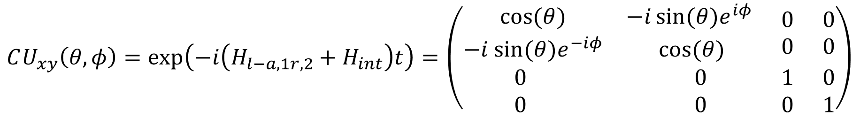
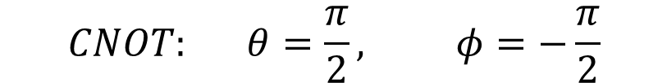
Two qubit gates on Rydberg
$$CU_{xy}\left(θ,φ\right)=\exp\left(−i\left(H_{l−a,1r,2}+H_{int}\right)t\right)=\left(\begin{matrix}\begin{matrix}\cos{(θ)} & −i\sin{(θ)e^{iφ}} \\ −i sin⁡(θ)e^{−iφ} & \cos{(θ)}\end{matrix} & \begin{matrix}0 & 0 \\ 0 & 0\end{matrix} \\ \begin{matrix}0 & 0 \\ 0 & 0\end{matrix} & \begin{matrix}1 & 0 \\ 0 & 1\end{matrix}\end{matrix}\right)$$
$$V≫Ω, V=\frac{2πm}{t}, θ=Ωt, Δ=0$$
$$CNOT: θ=\frac{π}{2}, φ=−\frac{π}{2}$$
Can create universal gate set!

Slide 11
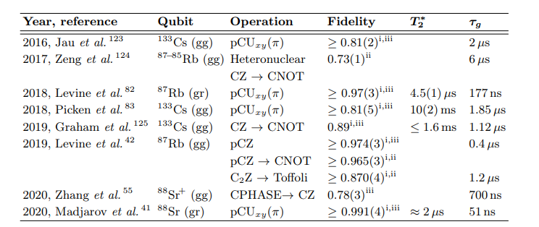
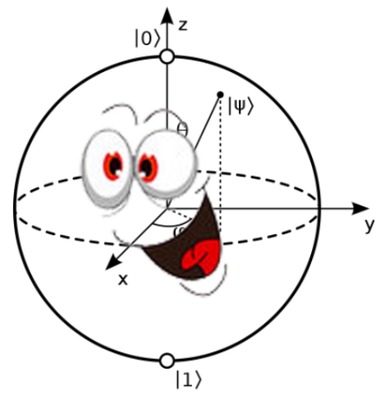

Two qubit gates on Rydberg
Source: (MW)

Slide 12


JUPYTER NOTEBOOK TIME

Slide 13
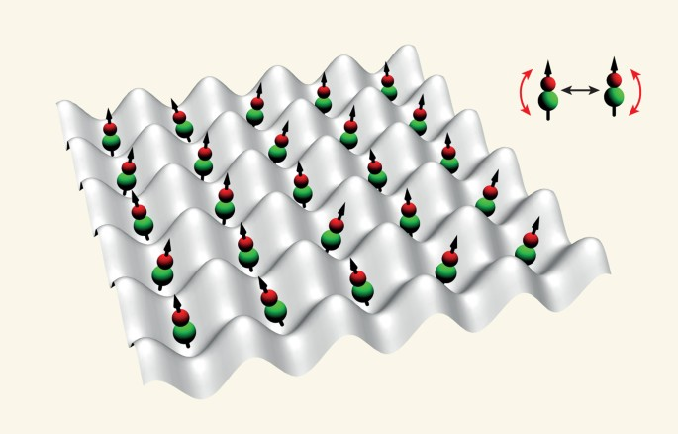
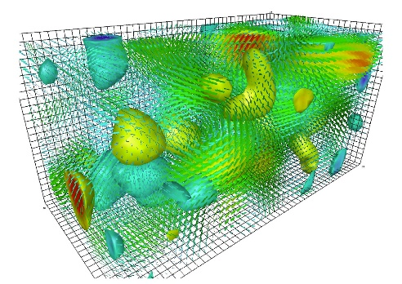
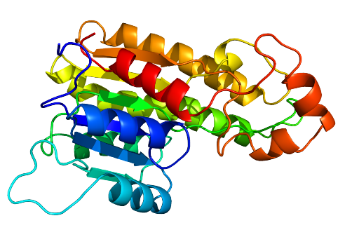
The basics of quantum computing
Recap Lecture 1
What can we get from quantum computers?
Quantum materials
Quantum field theories
Proteins and medicines

Slide 14
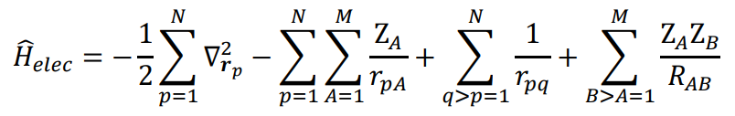
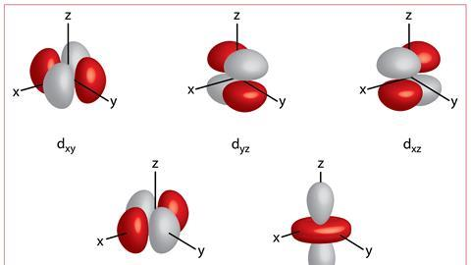


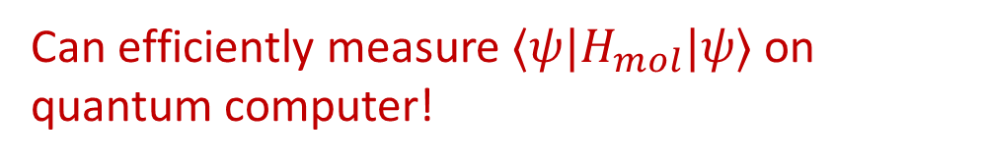
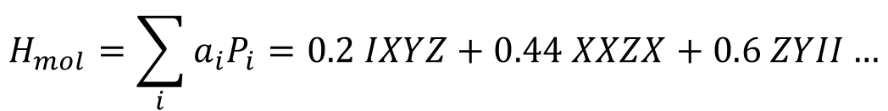
H
Li
Second quantization
$${\hat{H}}_{elec}=\sum_{i,j}{h_{ij}{\hat{a}}_{i}^{†}{\hat{a}}_{j}}+\frac{1}{2}\sum_{ijkl}{h_{ijkl}{\hat{a}}_{i}^{†}{{\hat{a}}_{j}^{†}\hat{a}}_{l}{\hat{a}}_{k}}+E_{NN}$$
Jordan-Wigner
Parity mapping
Bravyi-Kitaev
Fermion-to-qubit mapping
$$H_{mol}=\sum_{i}{a_{i}P_{i}=0.2 IXYZ+0.44 XXZX+0.6 ZYII…}$$
Can efficiently measure $⟨ψ|H_{mol}|ψ⟩$ on quantum computer!

Slide 15
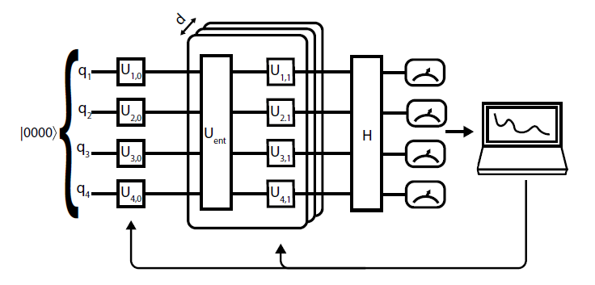

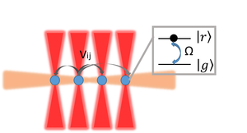


Hybrid quantum computers
Quantum Space Search
Classical Optimization
Source: Wu (2020) “Rydberg-Atom Simulator and Quantum Many-Body Scars”
Source: Networkworld.com

Slide 16
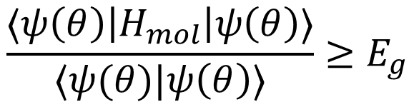
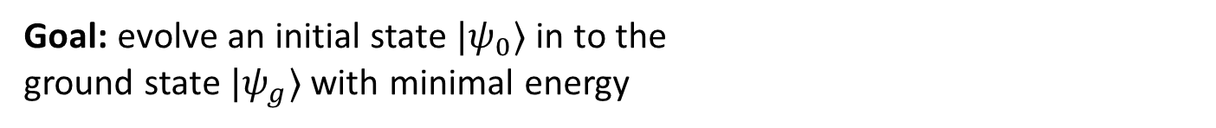

Variational principle
Task: Find the ground state energy of $H_{mol}$
$$\frac{〈ψ\left(θ\right)\left|H_{mol}\right|ψ\left(θ\right)〉}{〈ψ(θ)|ψ\left(θ\right)〉}≥E_{g}$$
= minimal eigenvalue
Goal: evolve an initial state $|ψ_{0}〉$ in to the
ground state $|ψ_{g}〉$ with minimal energy
$$⟹$$
VQA

Slide 17
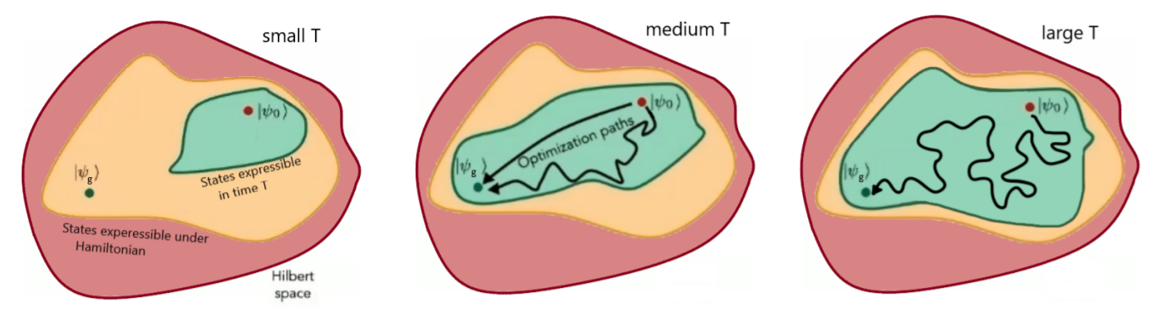
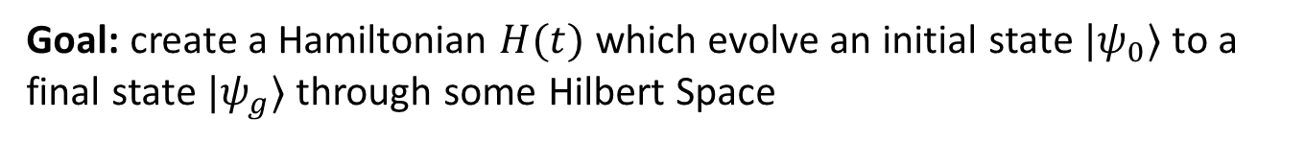
Quantum Speed Limit
Goal: create a Hamiltonian $H(t)$ which evolve an initial state $|ψ_{0}〉$ to a final state $|ψ_{g}〉$ through some Hilbert Space
$$t∈\left[0,T\right]: i∂_{t}U\left(t\right)=H\left(t\right)U\left(t\right), U\left(0\right)=I,…|ψ\left(t\right)〉=U(t)|ψ_{0}〉$$

Slide 18
Quantum Speed Limit
Goal: create a Hamiltonian $H(t)$ which evolve an initial state $|ψ_{0}〉$ to a final state $|ψ_{g}〉$ through some Hilbert Space
$$t∈\left[0,T\right]: i∂_{t}U\left(t\right)=H\left(t\right)U\left(t\right), U\left(0\right)=I,…|ψ\left(t\right)〉=U(t)|ψ_{0}〉$$
dimensionless
$$⇒τ∈\left[0,1\right]: i∂_{τ}\tilde{U}\left(τ\right)=\tilde{H}(τ)T\tilde{U}\left(τ\right)$$

Slide 19
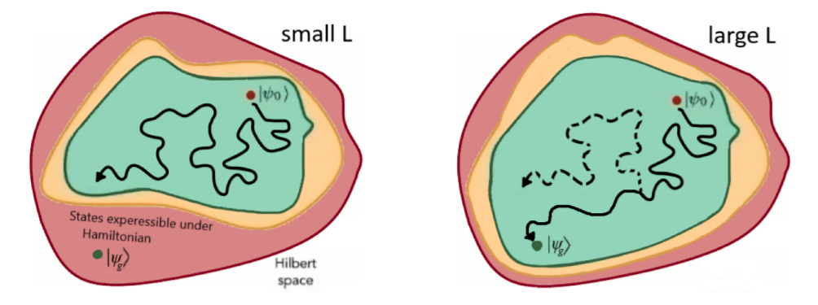
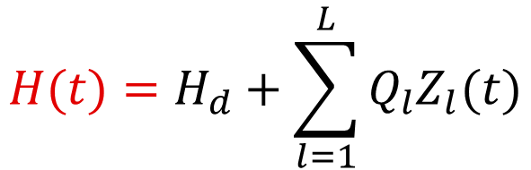
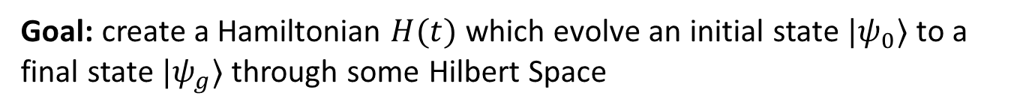
Controllability
Goal: create a Hamiltonian $H(t)$ which evolve an initial state $|ψ_{0}〉$ to a final state $|ψ_{g}〉$ through some Hilbert Space
$$t∈\left[0,T\right]: i∂_{t}U\left(t\right)=H\left(t\right)U\left(t\right), U\left(0\right)=I,…|ψ\left(t\right)〉=U(t)|ψ_{0}〉$$
$$H(t)=H_{d}+\sum_{l=1}^{L}{Q_{l}Z_{l}(t)}$$

Slide 20
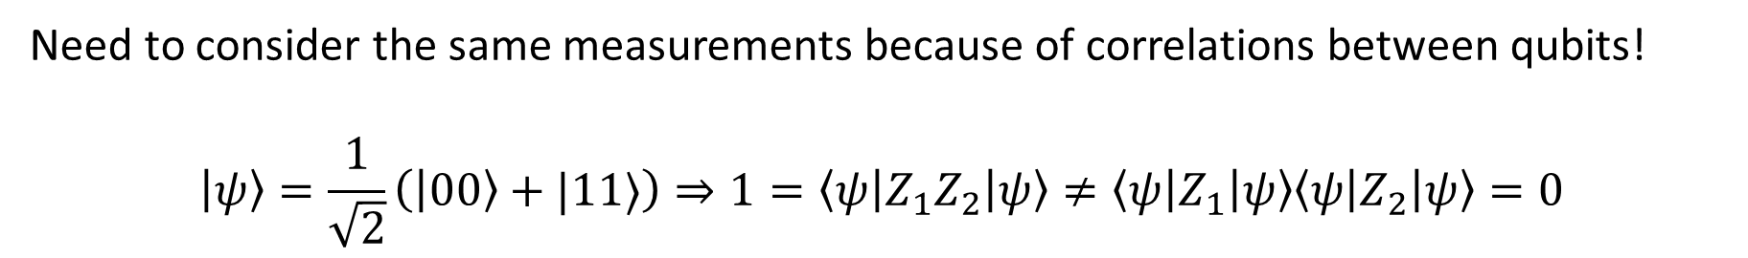
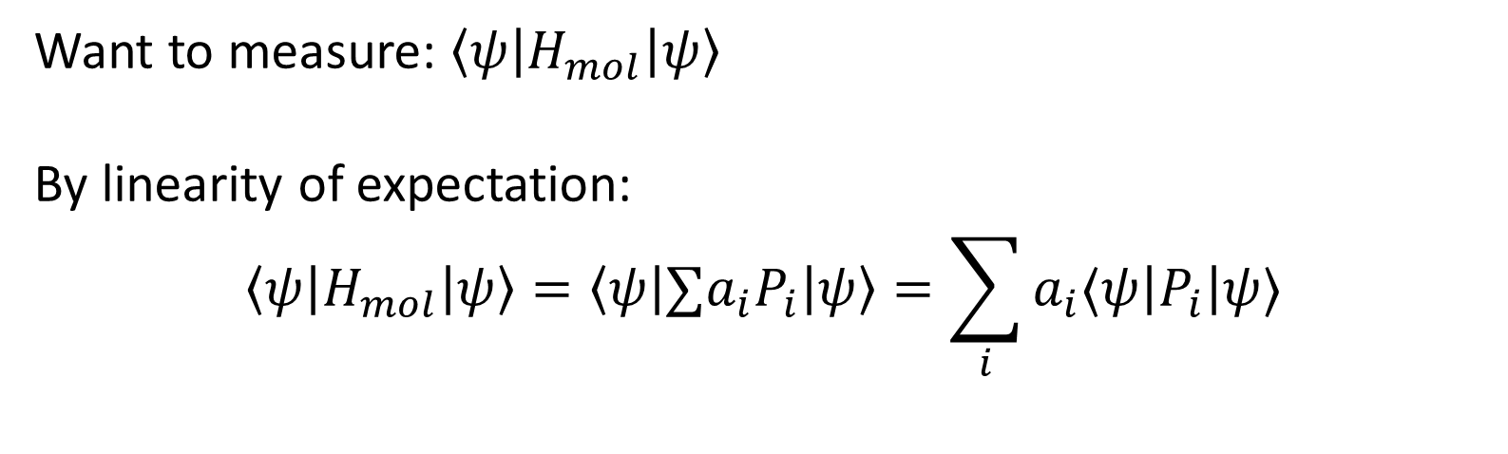
Measuring energies on QC
Want to measure: $〈ψ\left|H_{mol}\right|ψ〉$
By linearity of expectation:
$$〈ψ\left|H_{mol}\right|ψ〉=\left\langle ψ\right|∑a_{i}P_{i}\left|ψ\right\rangle =\sum_{i}{a_{i}⟨ψ\left|P_{i}\right|ψ⟩}$$
Need to consider the same measurements because of correlations between qubits!
$$\left|ψ\right\rangle =\frac{1}{\sqrt{2}}\left(\left|00\right\rangle +|11⟩\right)⇒1=\left\langle ψ\left|Z_{1}Z_{2}\right|ψ\right\rangle ≠\left\langle ψ\left|Z_{1}\right|ψ\right\rangle \left\langle ψ\left|Z_{2}\right|ψ\right\rangle =0$$

Slide 21
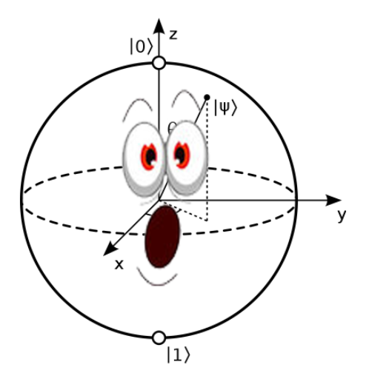
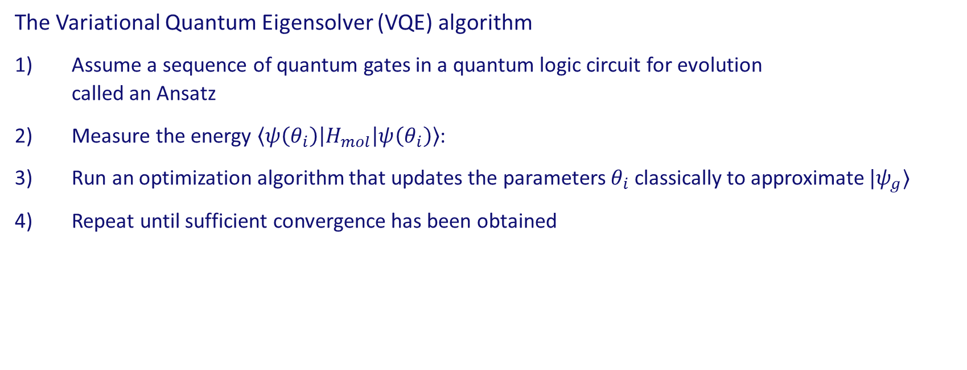
VQE Algorithm
The Variational Quantum Eigensolver (VQE) algorithm
Assume a sequence of quantum gates in a quantum logic circuit for evolution called an Ansatz
Measure the energy $\left\langle ψ\left(θ_{i}\right)\right|H_{mol}\left|ψ\left(θ_{i}\right)\right\rangle$:
Run an optimization algorithm that updates the parameters $θ_{i}$ classically to approximate $|ψ_{g}〉$
Repeat until sufficient convergence has been obtained
Quantum Space Search
Classical Optimization

Slide 22
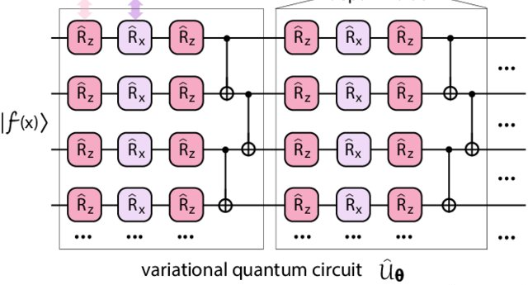
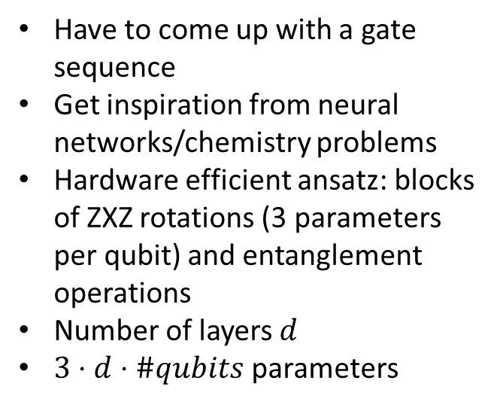
VQE
Have to come up with a gate sequence
Get inspiration from neural networks/chemistry problems
Hardware efficient ansatz: blocks of ZXZ rotations (3 parameters per qubit) and entanglement operations
Number of layers $d$
$3⋅d⋅\#qubits$ parameters
Source: DOI: 10.1103/PhysRevA.103.052416

Slide 23
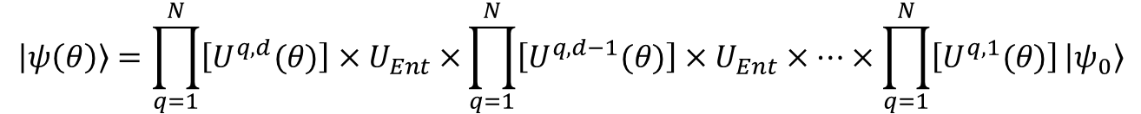
VQE
Have to come up with a gate sequence
Get inspiration from neural networks/chemistry problems
Hardware efficient ansatz: blocks of ZXZ rotations (3 parameters per qubit) and entanglement operations
Number of layers $d$
$3⋅d⋅\#qubits$ parameters
Source: DOI: 10.1103/PhysRevA.103.052416
$$\left|ψ\left(θ\right)\right\rangle =\prod_{q=1}^{N}{\left[U^{q,d}(θ)\right]×U_{Ent}×}\prod_{q=1}^{N}{\left[U^{q,d−1}(θ)\right]×U_{Ent}×…}×\prod_{q=1}^{N}{\left[U^{q,1}(θ)\right]}\left|ψ_{0}\right\rangle$$

Slide 24
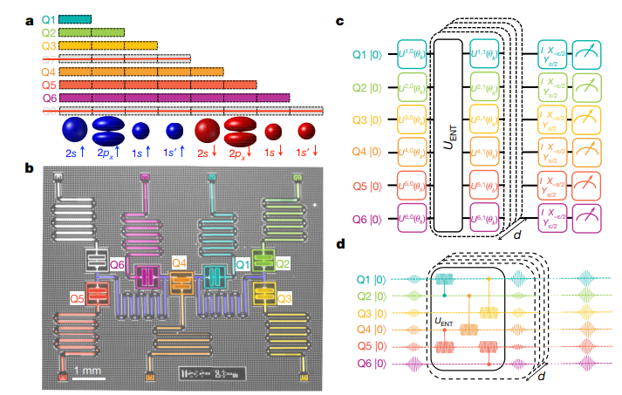
VQE
Parity mapping of Hamiltonian
Hardware efficient ansatz
Pulse implementation of gates
Superconducting
Quantum co-processor
Source: (KA)

Slide 25
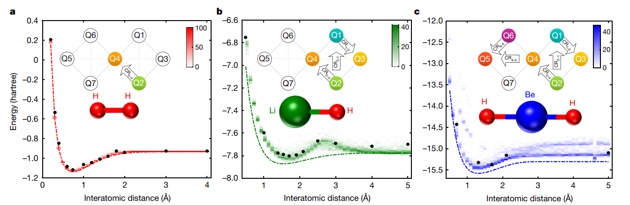
Experimental Results
Source: (KA)

Slide 26
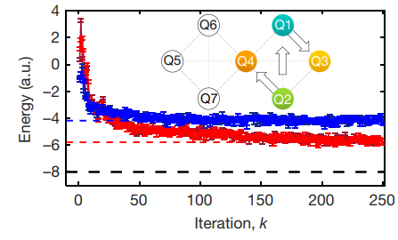

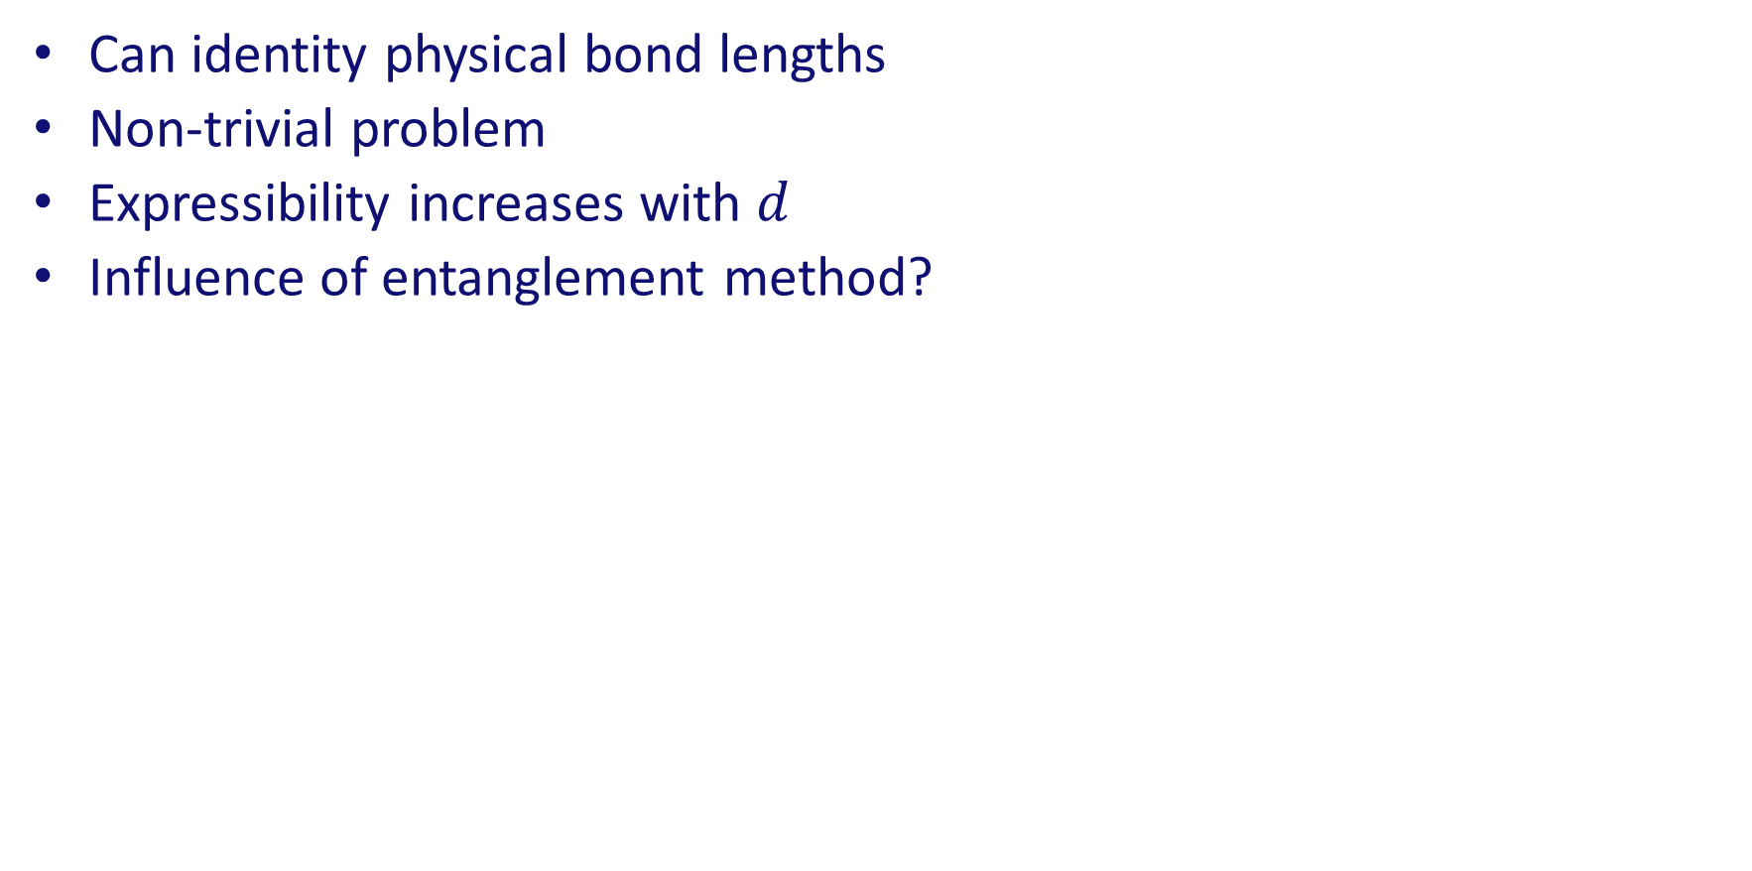
Experimental Results
Can identity physical bond lengths
Non-trivial problem
Expressibility increases with $d$
Influence of entanglement method?
d=0
d=2
Source: (KA)

Slide 27
JUPYTER NOTEBOOK TIME

Slide 28

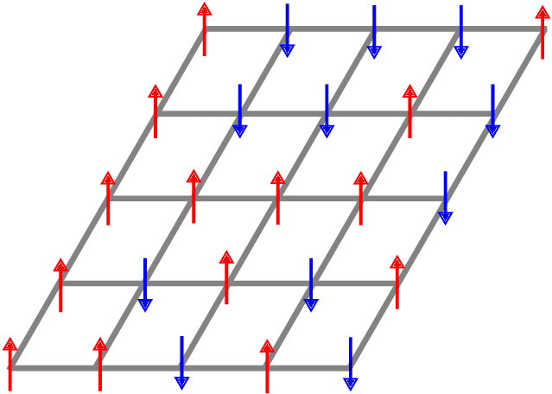

Lecture 1
Lecture 2
Lecture 3
Lecture 4
Qubits
Quantum Gates
Quantum Circuits
Neutral Atoms
Laser Cooling
Rydberg States
Quantum Simulation
Quantum Dynamics
Ising Models
Creating Gates
Quantum Chemistry
VQAs

Slide 29
Thank
you for
joining!

